Slide 1

UNIT-I
LEXICAL ANALYSIS
SCS1303 Compiler Design
1

Slide 2
UNIT 1 LEXICAL ANALYSIS
Structure of compiler
Functions and Roles of lexical phase
Input buffering
Representation of tokens using regular expression
Properties of regular expression
Finite Automata
Regular Expression to Finite Automata
NFA to Minimized DFA.
SCS1303 Compiler Design

Slide 3
Outline
Specification of tokens
  Strings and Languages
  Regular Expressions
Recognition of tokens
  Transition Diagrams
A Language for specifying Lexical Analyzer
  LEX Tool
SCS1303 Compiler Design

Slide 4
Specification of tokens
In theory of compilation regular expressions are used to formalize the specification of tokens.
While they cannot express all possible patterns, they are very effective in specifying those types of patterns that we actually need for token.
Regular expressions are means for specifying regular languages.
Example:
    letter_(letter | digit)*
SCS1303 Compiler Design

Slide 5

Strings and Languages
Alphabet:
  An alphabet is any finite set of symbols such as letters, digits and punctuation.(denoted by )
  The set {0,1} is binary alphabet
  String: (denoted by w or s)
    Finite sequence of symbol on an alphabet.
    Sentence and word are also used in terms of string.
    ε is the empty string.
    |s| is the length of string s.
    Language: (denoted by L)
      Set of strings over some fixed alphabet.
      Ø representing empty set ,{ε} is a language.
      Set of all possible identifiers is a language.
SCS1303 Compiler Design

Slide 6
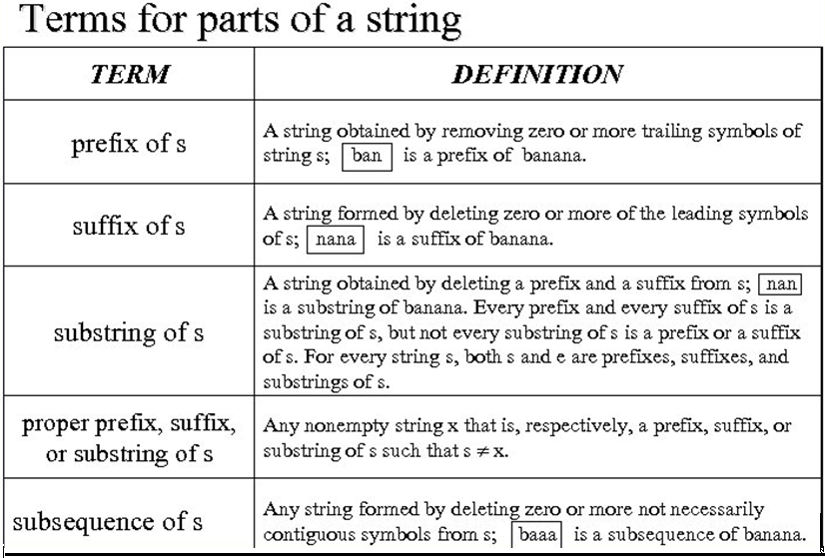
SCS1303 Compiler Design

Slide 7
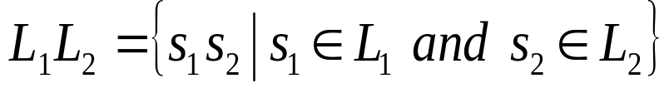
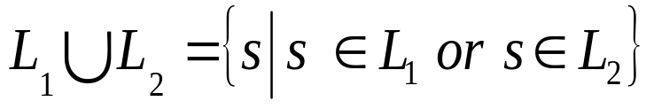
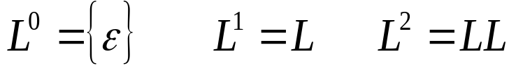
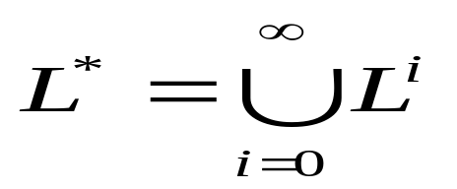
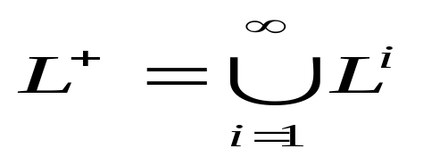
Operations on Languages
Concatenation:
Union:
Exponentiation:
Kleene’s Closure:
Positive Closure:
SCS1303 Compiler Design

Slide 8
Examples
Consider
L₁ ={A,B,…..,Za,b,……,z} L₂ ={0,1,2,….,9}
  L₁L₂ = {a1,a2,b1,b2,c1,c2,d1,d2….} i.e. set of string consisting of a letter followed by digit.
  L₁U L₂ = {ab,c,d,1,2….} i.e. set of letters and digit.
  L₁³ = all strings with length three using L₁
  L₁* = set of all strings of letters ,including ε,the empty string.(zero or more occurrences)
  L₂⁺ = set of all strings of one or more numbers. (one or more occurrences)
  L₁ (L₁U L₂)* =?
SCS1303 Compiler Design

Slide 9
Regular Expressions(RE)
RE is used to describe tokens of a programming language.
Each RE denotes a language.
A language denoted by a RE is called as a regular set.
Definition of RE:
ε is a regular expression, L(ε) = {ε}
If a is a symbol in ∑ then a is a regular expression, L(a) = {a}
Suppose r and s are regular expressions denoting the language L(r) and L(s)
  (r) | (s) is a regular expression denoting the language L(r) ∪ L(s)
  (r)(s) is a regular expression denoting the language L(r)L(s)
  (r)* is a regular expression denoting (L(r))*
  (r) is a regular expression denoting L(r)
SCS1303 Compiler Design

Slide 10
Unnecessary parenthesis can be avoided in regular expression if we adopt the conventions that:
  The unary operator * has the higher precedence and is left associative.
  Concatenation has the second highest precedence and is left associative.
  | has the lowest precedence and is left associative.
  Under these conventions (a)|((b)*(c)) is equivalent to a|b*c.
  denote the set of strings that are either a single a or zero or more b’s followed by one c .
SCS1303 Compiler Design

Slide 11
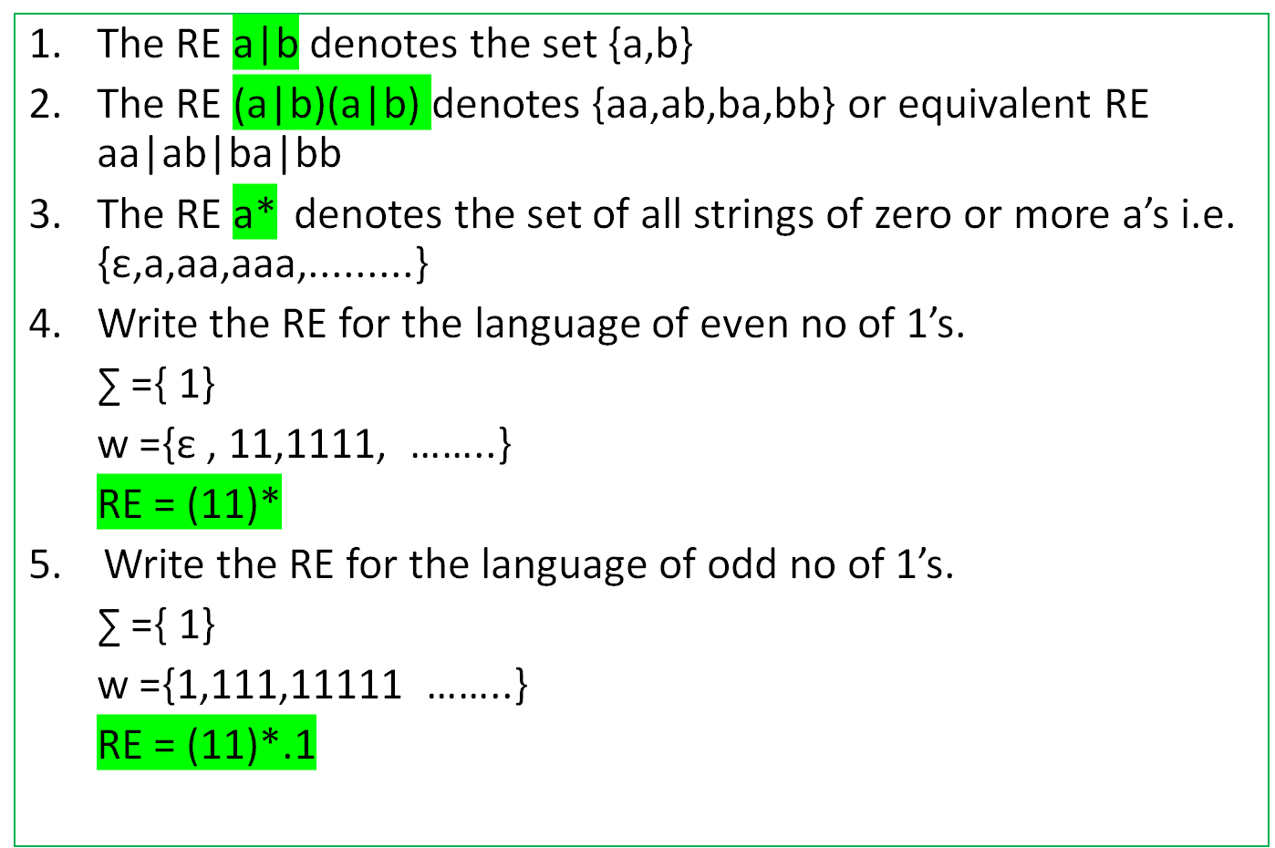
Writing Regular Expressions
SCS1303 Compiler Design

Slide 12
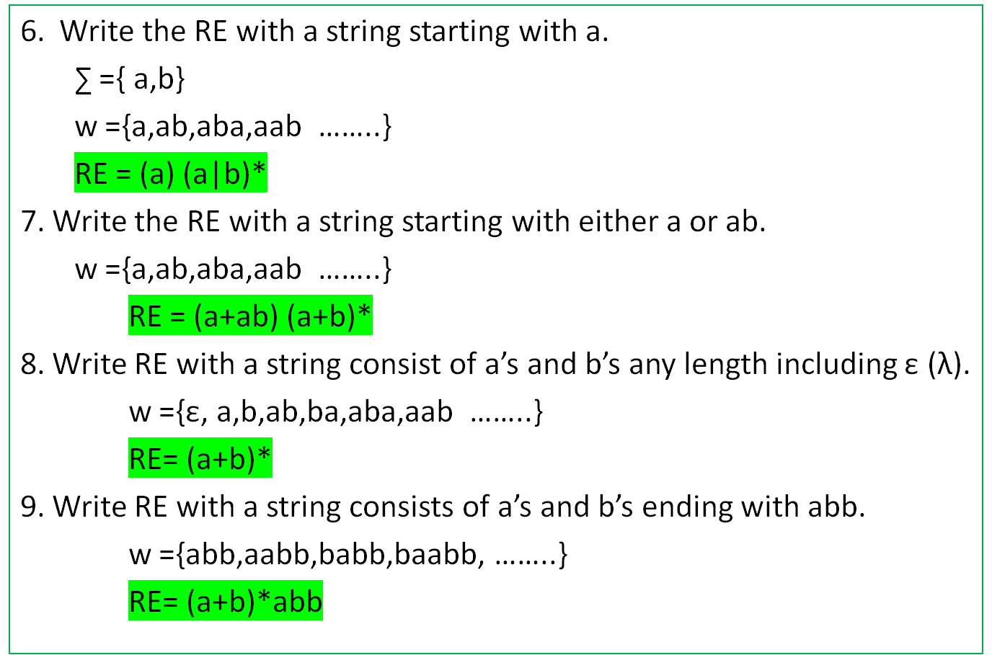
Writing Regular Expressions
SCS1303 Compiler Design

Slide 13
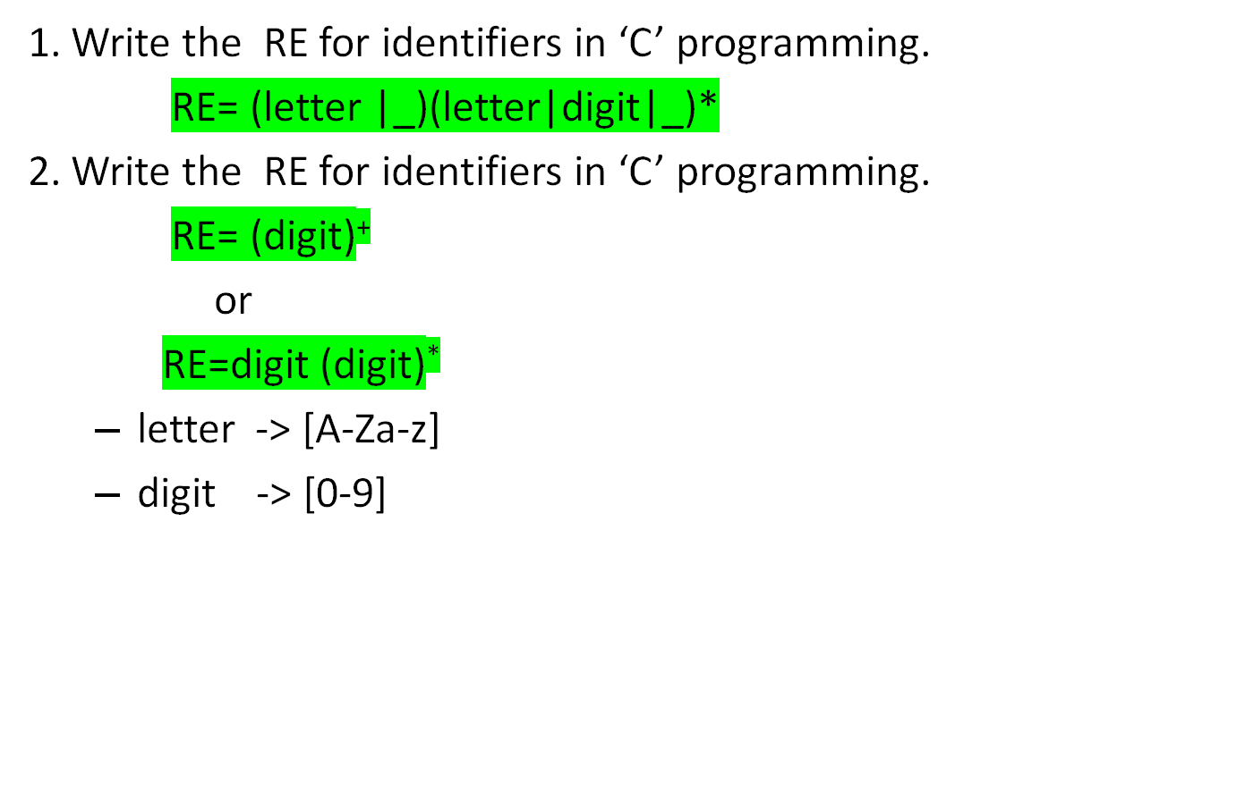
Writing Regular Expressions
SCS1303 Compiler Design

Slide 14
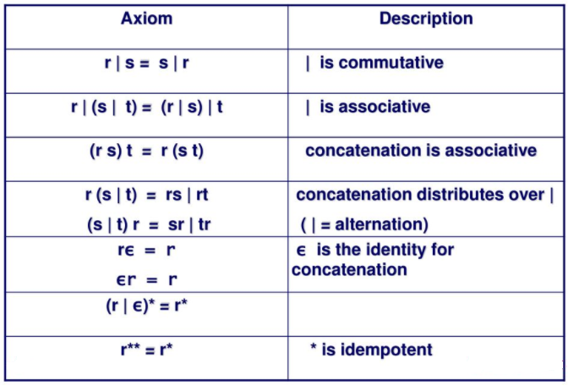
Algebraic properties of RE
relation between * and ε
where r,s,and t are regular expressions
SCS1303 Compiler Design

Slide 15
Regular Definitions
Giving names to regular expression and define RE using these names.
Regular definition is a sequence of definitions of the form,
d₁ r₁
d₂ r₂
…
d_{n} r_{n}
Where d_{i} is a each r_{i} is a regular expression over the symbols in ∑ U {d₁, d₂ ,…… d_{i-1} }
Examples:
  letter A | B | … | Z | a | b | … | z
  digit 0 | 1 | … | 9
  identifier letter(letter| digit)*
SCS1303 Compiler Design

Slide 16
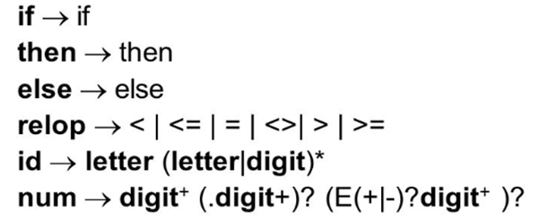

Recognition of tokens
Knowing how to specify the tokens for a language ,we need to know how to recognize them.
We also need to handle whitespaces:
SCS1303 Compiler Design

Slide 17
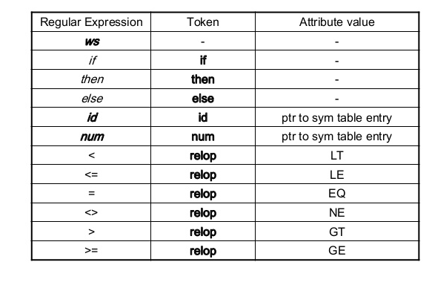
Regular Expression patterns for tokens
SCS1303 Compiler Design

Slide 18
Transition Diagrams
Lexical Analysis use transition diagram to keep track of information about characters that are seen as the forward pointer scans the input.
Positions in a transition diagram are drawn as circles and are called states.
The states are connected by arrows called edges.
A double circle indicates an accepting state ,in which a token is found.
* indicates that input retraction must take place.
SCS1303 Compiler Design

Slide 19
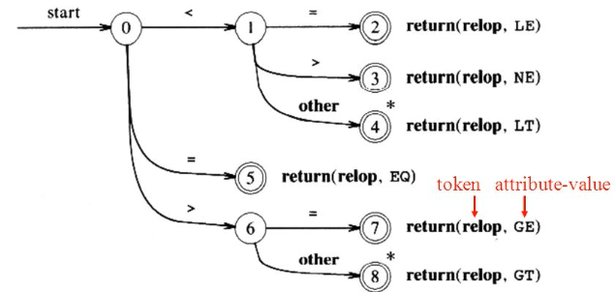
Transition diagrams
Transition diagram for relop
SCS1303 Compiler Design

Slide 20
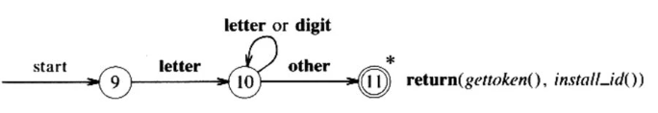
Transition diagrams (contd.)
Transition diagram for reserved words and identifiers
gettoken(): return token(id,if.then,.....)if it looks the symbol table
Install_id(): return 0 if keyword or a pointer to the symbol table entry if id.
SCS1303 Compiler Design

Slide 21
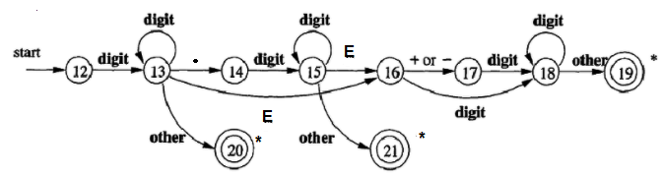

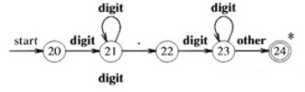

Transition diagrams (contd.)
Fractional part
Transition diagram for unsigned numbers
Exponential part
install_num()
install_num()
install_num()
SCS1303 Compiler Design

Slide 22
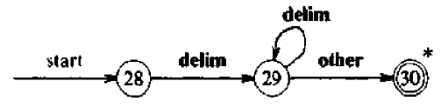
Transition diagram for whitespace
Nothing is returned when the accepting state is reached.
Goes back to first transition diagram to look for another pattern.
SCS1303 Compiler Design

Slide 23
Following Transition diagrams
Transition diagrams are followed one by one trying to determine the next tokens to be returned.
If failure occurs ,we retract(*) the forward pointer to where it was in the start state of the diagram, and activate the next transition diagram.
If failure occurs in all diagrams then a lexical error has been detected and we invoke an error-recovery routine.
Implement a Transition Diagram
  A sequence of transition diagrams can be converted into a program to look for tokens.
  Each state gets a segment of code.
SCS1303 Compiler Design

Slide 24
Implementation of Transition Diagram
state- for the current state
start-for the start state of current transition diagram
lexical_value:
  assigns the pointer returned by install_id() and install_num() when an identifier or number is found.
  fail()-when a transition diagram fails.
    Retract the forward pointer to the position of the lexeme beginning pointer and to return to the start state of next diagram.
    If all diagram fails the function fail() calls an error recovery routine.
SCS1303 Compiler Design

Slide 25
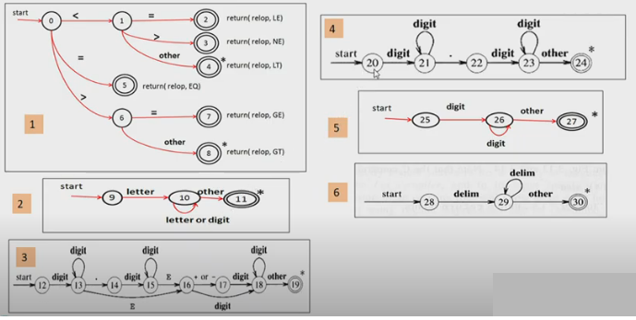
Transition Diagram for all tokens
SCS1303 Compiler Design

Slide 26
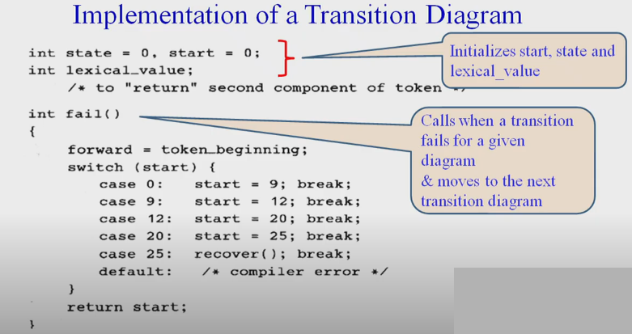
SCS1303 Compiler Design

Slide 27
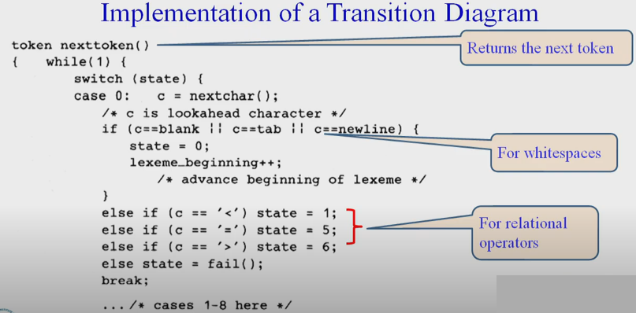
SCS1303 Compiler Design

Slide 28
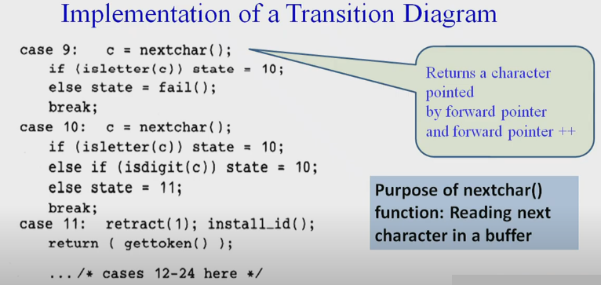
SCS1303 Compiler Design

Slide 29
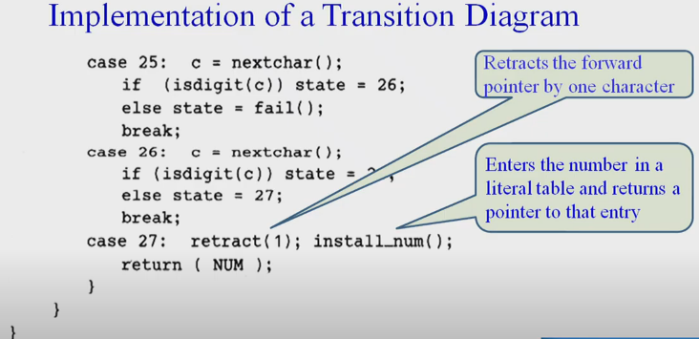
SCS1303 Compiler Design

Slide 30
Lexical Analyzer Generator - Lex
Lex Source program
lex.l
Lexical Compiler
lex.yy.c
C
compiler
lex.yy.c
a.out
a.out
Sequence of tokens
Input stream
SCS1303 Compiler Design

Slide 31
Structure of Lex programs
declarations
%%
translation rules
%%
auxiliary functions
Pattern {Action}
SCS1303 Compiler Design

Slide 32
LEX program
%{
/* definitions of manifest constants
LT, LE, EQ, NE, GT, GE,
IF, THEN, ELSE, ID, NUMBER, RELOP */
%}
/* regular definitions
delim [ \t\n]
ws {delim}+
letter [A-Za-z]
digit [0-9]
id {letter}({letter}|{digit})*
number {digit}+(\.{digit}+)?(E[+-]?{digit}+)?
%%
{ws} {/* no action and no return */}
if {return(IF);}
then {return(THEN);}
else {return(ELSE);}
{id} {yylval = (int) install_id(); return(ID); }
{number} {yylval = (int) install_num(); return(NUMBER);}
…
%%
Int install_id() {/* funtion to install the lexeme, whose first character is pointed to by yytext, and whose length is yyleng, into the symbol table and return a pointer thereto */
}
Int install_num() { /* similar to installID, but puts numerical constants into a separate table */
}
SCS1303 Compiler Design

Slide 33
THANK YOU
SCS1303 Compiler Design

